Slide 1
Course Name: Operating System
Course Code: 13005100
File System Unit-3
Presented By: Ms. Sonam Pareek
Assistant Professor

Slide 2
Course Objective
To Understand the services provided by an operating system.
1. To acquire the fundamental knowledge of the operating system architecture and its components
2. To know the various operations performed by the operating system.
3. The Operating System will identify at which Time the CPU will perform which Operation and in which Time the Memory is used by which Programs.
4. Operating System Also Known as the Resource Manager Means Operating System will Manages all the Resources those are Attached to the System means all the Resource like Memory and Processor and all the Input output Devices those are Attached to the System

Slide 3
File System
It is the most visible aspect of operating system
Provides mechanism for storage & access to both data and programs of OS
Consists of two parts
collection of files
directory structure
Notes:
Provides mechanism for online storage & access to both data and programs of OS

Slide 4
File Concept
A file is named collection of related information that is recorded on secondary storage
It represents programs & data (numeric, alphabetic, alphanumeric & binary).
It is a sequence of bits, bytes, lines or records, the meaning of which is defined by the file’s creator & user
A file has a certain defined structure which depends on its type (text, source, object, executable)
Notes:
OS abstracts from the physical properties of its storage devices to define a logical storage unit – file. Files are mapped by OS onto physical devices.
Logically a file is sequence of logical records i.e. sequence of bits and bytes.
A file is a collection of similar records
Contents are persistent through power failures and system reboots.

Slide 5
File Attributes
Name – symbolic name in human-readable form
Identifier – unique tag identifying the file within the file system.
Type – needed for systems that support different types
Location – pointer to file location on device
Size – current file size
Protection – controls who can do reading, writing, executing
Time, date, and user identification – data for protection, security, and usage monitoring
Information about files are kept in the directory structure, which is maintained on the disk
Notes:
Every file have some attributes associated with it. These attributes vary based on the operating System. Some common attributes of file includes :
Name – used to refer a file in the system

Slide 6
File Operations
Create
Space in file system must be found for the file
An entry for new file must be made in directory
Write
System call specifies name of file & information to be written on file
System searches for file location
System must keep write pointer to the location
Read
System call specifies file name & location of next block of information
Read pointer kept at next location from where data is to be read

Slide 7
Reposition within file
file seek; don’t involve any I/O
Delete
Search for the file to be deleted
Release file space and erase directory entry
Truncate
Erase contents but keep the file structure
All attributes remains same but length becomes zero
Other operations on file
Append – writing at the end
Copy – copying file contents to another file
Get or set attributes of files

Slide 8
File Types
If an OS recognizes the type of file, it then operates in appropriate ways.
Name is split into 2 parts :
Name
Extension
OS uses the extension to indicate the type of the file and the type of the operations that can be done on the file
Notes:
File type is included as file extension.
From the type of the file user can identify what type of data is written in file. If OS recognized the file type then it can easily find out what kind of operations can be performed on the file.
3rd point→In this way, the user & OS can tell from the name alone what the type of the file is.

Slide 9
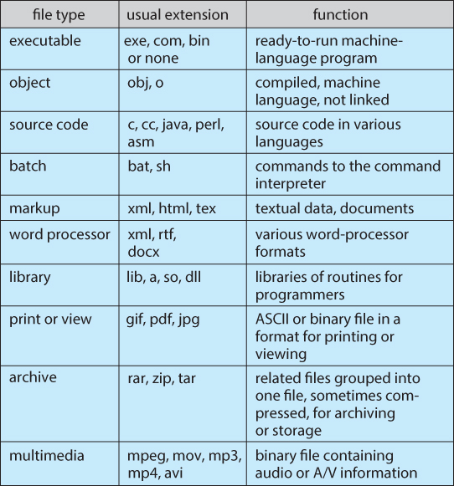
Notes:
asm → assembly file
.a files are static libraries typically generated by the archive tool. You usually include the header files associated with that static library and then link to the library when you are compiling.
A TAR file is a Consolidated Unix Archive file

Slide 10
File Structure
Different file types have different file structures
Ex. executable file structure stores where to load file in memory, what the location of first instruction is
Multiple file structures results in greater size of OS as it needs to have code to handle different file structures
Different file implementations-
Minimum number of file structures must be supported by OS
OS treats all files as same. Each application code must include its own code to interpret an input file as to the appropriate structure.
Notes:
OS treats all files as same (UNIX considers all files to be sequence of 8 bit bytes). Each application code must include its own code to interpret an input file as to the appropriate structure.
All disk I/O is performed in units of blocks. Some portion of the last block of each file is wasted.
Logical records may vary in length.
Packing a number of logical records into physical blocks can be done.
All file system suffer from Internal Fragmentation, the larger the block size, the greater the Internal Fragmentation.

Slide 11
Access Methods
File access mechanism refers to the manner in which the records of a file may be accessed.
Types :
Sequential access
Direct/Random access
Indexed sequential access
Notes:
→File store information. When it is used, this info. Should be accessed and used into computer memory.
The info. May be accessed in several ways
Some sys. Provide only one access method for file
Other sys. (IBM) support many access methods

Slide 12
Sequential Access
Information in the file is processed in order, one record after the other
E.g. – Editors & compilers access files in this fashion.
read next – reads the next portion of the file and automatically advances a file pointer
write next – appends to the end of the file and advances the end of the newly written data (new end of file)
For example magnetic tapes store information in sequential manner and retrieval is performed in the same manner
Notes:
Most common access method

Slide 13
Sequential Access

Slide 14
Direct Access
A file is made up of fixed length logical records that allow programs to read and write records rapidly in no particular order
It is based on the disk model of the file and it allows random access to any block
For direct access the file is treated as a numbered sequence of blocks or records
Hence we may read a block 12, then block 57 and then write block 6
There is no restriction on the order of reading or writing for a direct access file
read n and write n instead of read next and write next
Notes:
Eg. – Databases are often of this type.
Direct Access method can be used to access data stored on magnetic disks.
Direct access files are of great use for immediate access to a large amount of information

Slide 15
Simulation of sequential access on a direct-access file

Slide 16
Indexed Sequential Access
Built up on base of sequential access
An index is created for each file which contains pointers to various blocks
Index is searched sequentially and its pointer is used to access the file directly
Notes:
http://www.tutorialspoint.com/operating_system/os_file_system.htm

Slide 17
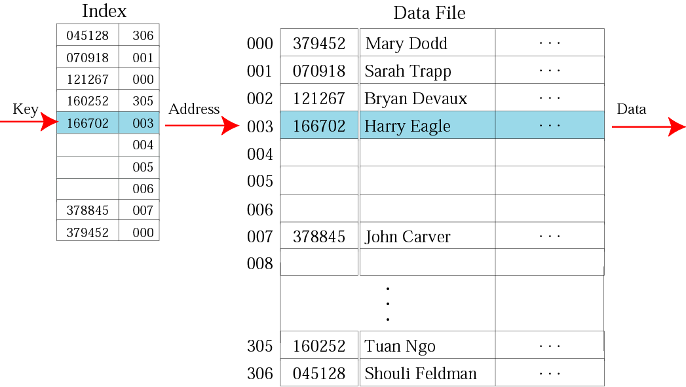

Slide 18
Directory Systems
Similar to symbol table that translates file names into their directory entries
Can be organized in many ways
Directory
Files
F 1
F 2
F 3
F 4
F n
Notes:
A collection of nodes containing information about all files
Both the directory structure and the files reside on disk
Backups of these two structures are kept on tapes

Slide 19
Directory Systems
Operations performed on directories :
Search
Create
Delete
List a directory : list the files in a directory & the contents of the directory entry for each file.
Rename
Traverse the file system

Slide 20
Directory Structure
Single-level directory
Two-level directory structure
Tree structured directories
Acyclic-Graph directories
General Graph directory
Notes:
There are different schemes for defining the logical structure of a directory.

Slide 21
Single-Level Directory
All files are contained in the same directory
A single directory for all users
Limitation – Naming problem
Notes:
Name collision problem

Slide 22
Two-Level Directory
Each user has his own user file directory (UFD)
When user logs in, systems Master file directory (MFD) is searched
MFD
indexed by user name or account no.
Each entry points to the UFD for that user.
Notes:
Separate directory for each user is maintained in the system
UFD contains files of a single user
When user refers to particular file, only his own UFD is searched.
Different users can have files with same name.
Limitations
- isolates one user from another
- to name a file both user name and file name has to be specified

Slide 23
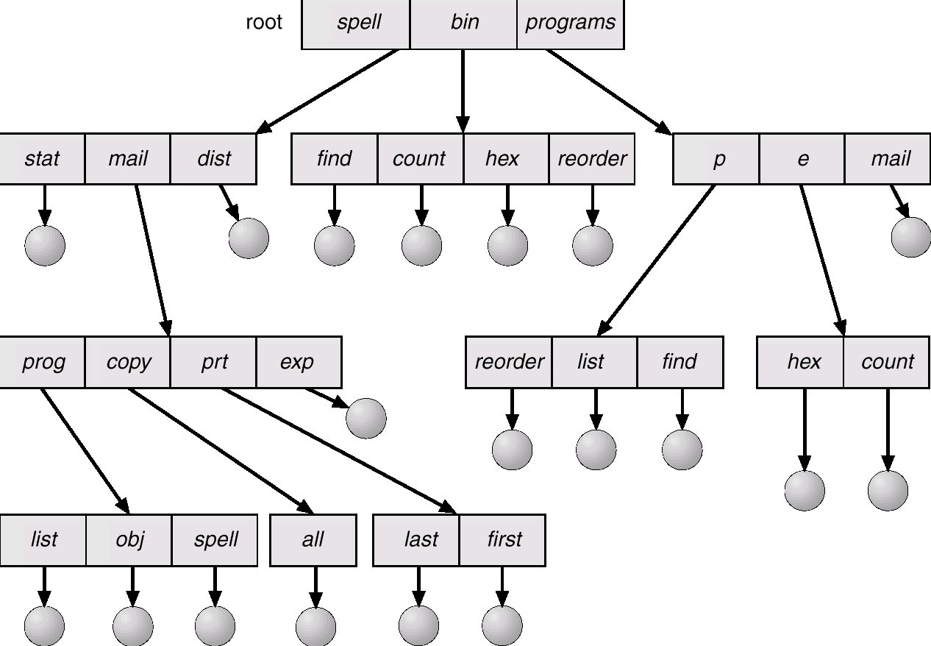
Tree Structured Directories
Notes:
Most common directory structure. Contains root directory.
directory contains set of files or subdirectories
Explain Absolute & Relative Path
If current Directory is root/spell/mail
Absolute path → root/spell/mail/prt/first
Relative path → prt/first

Slide 24
Tree Structured Directories
Every file in a system has a unique path name
One bit in each directory defines the entry as a file(0) or as a subdirectory(1)
Special system calls are used to create, delete or change current directories.
Path names can be of 2 types
Absolute path
Begins at the root & follows the path down to the specified file
Relative path
Defines path from current directory
Notes:
After 3rd point→ when reference is made to the file, it is first searched in current directory. If it is not in the current directory then the user must specify the complete path to access the file or change the current directory

Slide 25
Deletion of directory
First delete all the files and subdirectories in specific directory to delete that directory
Use a command eg, rm in UNIX which will first empty the directory and then remove directory.
rm <file-name>
Notes:
Some OS allows you to delete a directory even if it contains other subdirectories & files. Such as UNIX , which used rm command to delete a directory even if contains other files/subdirectories
OS like MS-DOS does not allow to delete the directory if it contains other files/ subdirectories.

Slide 26
Acyclic – Graph Directories
Allows shared subdirectories and files

Slide 27
Acyclic – Graph Directories
Two programmers working on a joint project, would like to have files associated with that project to be shared in a subdirectory
As both the programmers would like to have subdirectory under their own directories and hence the common subdirectory should be shared
The acyclic graph is a natural generalization of the tree-structured directory scheme
An acyclic graph (a graph with no cycles) allows directories to share subdirectories and files
Notes:
When the same files need to be accessed in more than one place in the directory structure ( e.g. because they are being shared by more than one user / process ), it can be useful to provide an acyclic-graph structure. ( Note the directed arcs from parent to child. )
UNIX provides two types of links for implementing the acyclic-graph structure. ( See "man ln" for more details. )
A hard link ( usually just called a link ) involves multiple directory entries that both refer to the same file. Hard links are only valid for ordinary files in the same filesystem.
A symbolic link, that involves a special file, containing information about where to find the linked file. Symbolic links may be used to link directories and/or files in other filesystems, as well as ordinary files in the current filesystem.
Windows only supports symbolic links, termed shortcuts.
Hard links require a reference count, or link count for each file, keeping track of how many directory entries are currently referring to this file. Whenever one of the references is removed the link count is reduced, and when it reaches zero, the disk space can be reclaimed.
For symbolic links there is some question as to what to do with the symbolic links when the original file is moved or deleted:
One option is to find all the symbolic links and adjust them also.
Another is to leave the symbolic links dangling, and discover that they are no longer valid the next time they are used.
What if the original file is removed, and replaced with another file having the same name before the symbolic link is next used?

Slide 28
There exists only one copy of the file and any changes made by one is immediately visible to the other
Sharing is particularly for subdirectories; a new file created by one person will automatically appear in all the shared subdirectories
Shared files and subdirectories can be implemented in several ways
A common way adopted in UNIX system is to create a new directory entry called link
Link is effectively a pointer to another file or subdirectory
An acyclic-graph directory structure is more flexible than a simple tree structure, but is more complex
Notes:
Implementation of shared files and subdirectories
Through a link given at each location.
File is stored once
Duplicating files at all location
If any shared file deleted⇒ dangling pointer
Solutions:
Store information about all links somewhere, so we can delete all pointers
Leave the link until attempt is made to use them
Entry-hold-count solution

Slide 29
A file may now have multiple absolute path names and two distinct file names may refer to the same file
The primary advantage of an acyclic graph is the relative simplicity of the algorithm to transverse the graph and to determine when there are no more reference to the file
Adding a new link or directory entry increments the reference count; deleting a link or entry decrements the count
If we want to delete a file, we can check the value of reference count, if it is zero that means there are no more reference to the file or directory and hence can be deleted

Slide 30
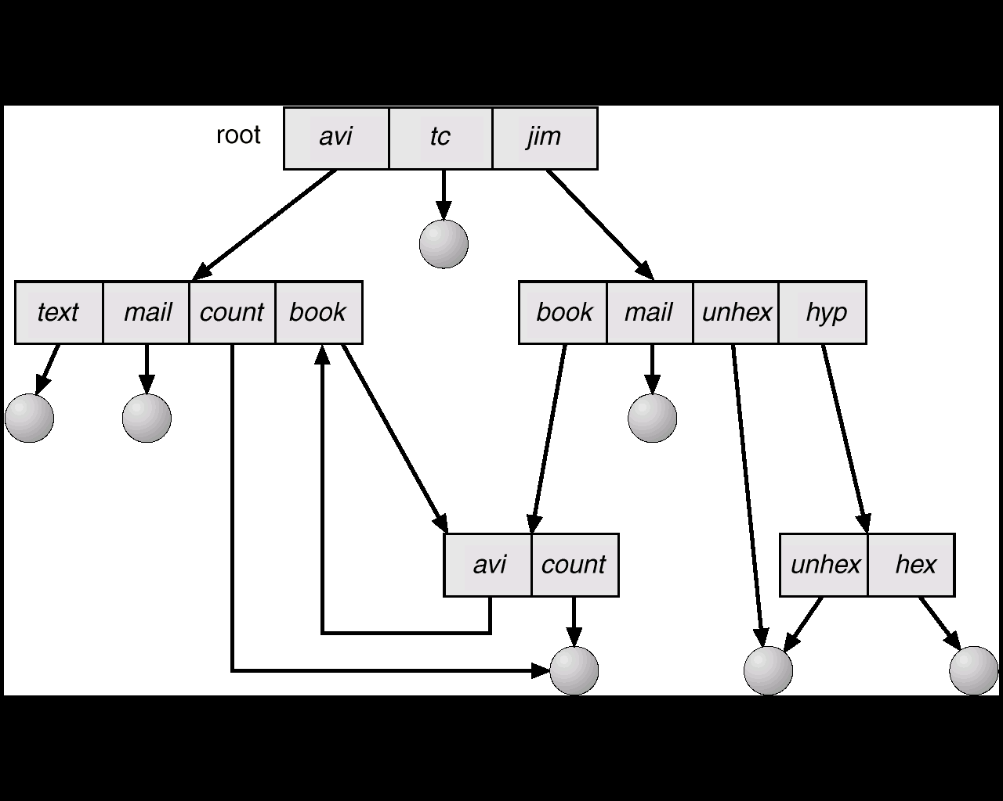
General Graph Directory
When links are added to an existing tree-structured directory, a general graph structure can be created
Notes:
If cycles are allowed in the graphs, then several problems can arise: Search algorithms can go into infinite loops. One solution is to not follow links in search algorithms. ( Or not to follow symbolic links, and to only allow symbolic links to refer to directories. )
Sub-trees can become disconnected from the rest of the tree and still not have their reference counts reduced to zero. Periodic garbage collection is required to detect and resolve this problem. ( chkdsk in DOS and fsck in UNIX search for these problems, among others, even though cycles are not supposed to be allowed in either system. Disconnected disk blocks that are not marked as free are added back to the file systems with made-up file names, and can usually be safely deleted. )

Slide 31
General Graph Directory
A general graph can have cycles and cycles cause problems when searching or traversing file system
How do we guarantee no cycles?
Allow only links to files not subdirectories
Every time a new link is added, use a cycle detection algorithm to determine whether a cycle now exists
Notes:
How to release orphan cycles - Use Garbage collection.
An alternative approach – to bypass links during directory traversal.
How do we guarantee no cycles?
Cycle might be created when we add any link
Allow only links to file not subdirectories
Every time a new link is added use a cycle detection algorithm to determine whether it is OK
A simpler algorithm is to bypass links during directory traversal, so that cycles are avoided and no extra overhead is incurred
Problem with acyclic graph is to ensure that there is no cycle in the graph
Garbage collection
involves traversing the entire file system ,marking every thing that can be accessed
Determine when the last reference has been deleted and disk space can be reallocated

Slide 32
Allocation Methods
How to allocate space to files so that disk space is utilized effectively and files can be accessed quickly
Three major methods of allocating disk space are in wide use
Contiguous allocation
Linked allocation
Indexed allocation
Each method has its own advantages and disadvantage
Notes:
Main problem is how the space is allocated to these files, so that the disk space is utilized effectively and file can be accessed quickly

Slide 33
Contiguous Allocation
Each file occupies a set of contiguous blocks on the disk
Disk addresses define a linear ordering on the disk
With this ordering, assuming that only one job is accessing the disk, there is no head movement required, even if required it is to the next track
Hence the disk seek time is minimal
Directory entry for each file has address of starting block and length of area allocated for this file
File access : both sequential as well as direct access is supported
Notes:
For direct access – to access block i of a file that starts at block b, immediately access block b + i

Slide 34
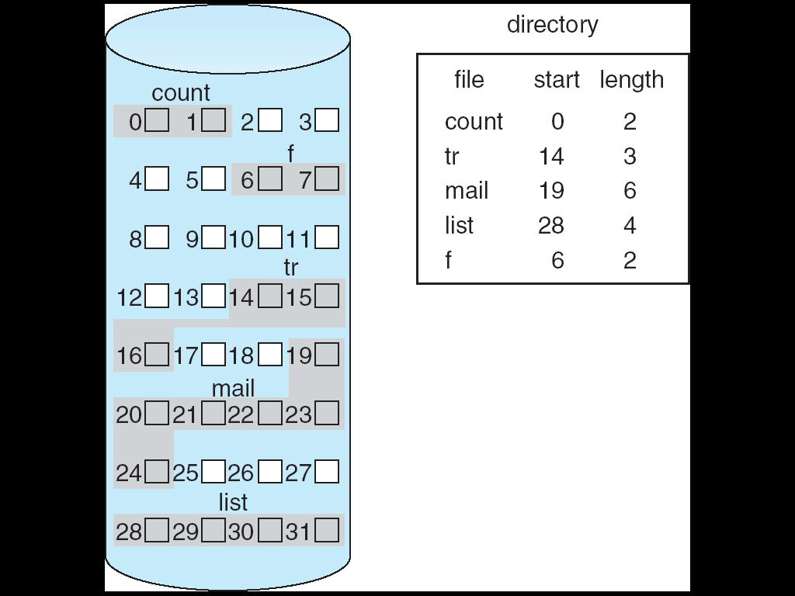

Slide 35
Linked Allocation
Each file is a linked list of blocks; blocks may be scattered anywhere on the disk
Directory contains a pointer to first & last blocks of file
Each block contains pointer to next block
File ends at nil pointer
No external fragmentation
Free space management system called when new block needed; file can continue to grow
Disadvantage :
Used only for sequential access files.
Space required for pointer
Notes:
Solves the problem of contiguous allocation as it does not suffer from external fragmentation
Disadv :
Used only for sequential access files. To access ith block of the file we must start at the beginning of the file & then follow the pointer
Space required for pointer

Slide 36
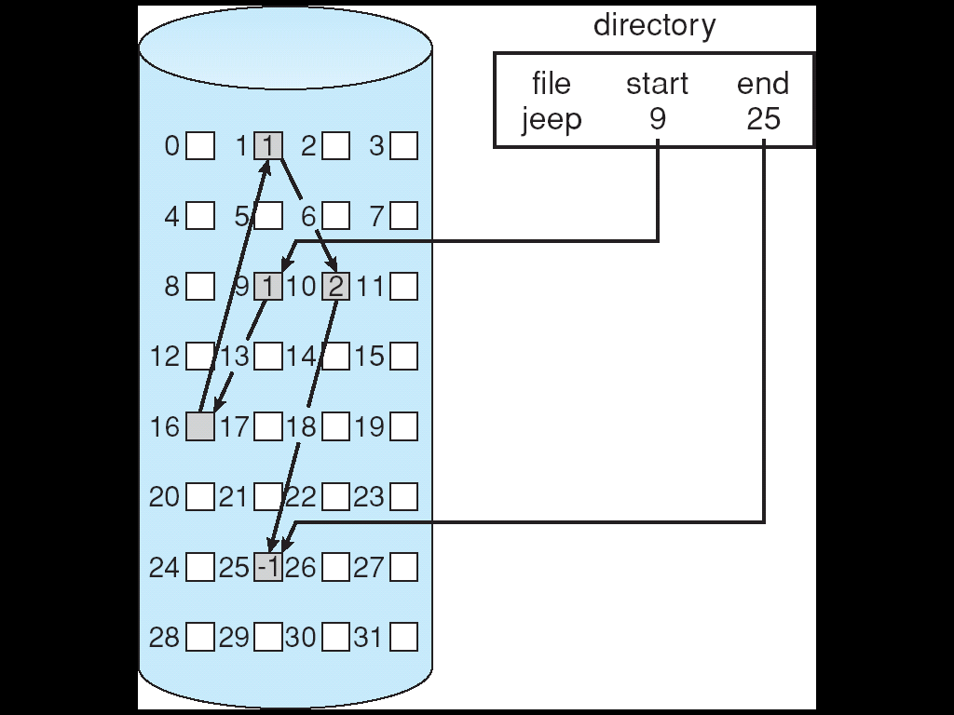
Notes:
To find i^{th} block , must start from the beginning and follow all pointers until it reaches i^{th} block
Each file requires more space than the actual required one, to store all pointers
- solution: allocate cluster rather than blocks
Reliability issue due damage or loss of pointers

Slide 37
No direct access - To find i^{th} block, must start from the beginning and follow all pointers until it reaches i^{th} block
Each file requires more space than the actual required one, to store all pointers.
Solution- collect blocks into multiples, called clusters and to allocate clusters rather than blocks. But increases internal fragmentation
Reliability lost if pointer lost or damaged
Locating a block can take many I/Os and disk seeks – solution file allocation table
Notes:
Reliability problem → pointer is lost
Ex. Cluster – 4 blocks. Less pointers required

Slide 38
File-Allocation Table
FAT (File Allocation Table)
It has 1 entry for each disk block & is indexed by block number
Much like a linked list, but faster on disk and cacheable
New block allocation simple
Notes:
Section of disk at beginning of each volume is kept aside for FAT.
If FAT not cached, disk head must move to start of volume to read FAT & find location of block in question, then move to the location of block itself.
Random access improved – disk head can find location of any block by reading information in FAT
An important variation on linked list is the use of FAT. Used in MS-DOS os

Slide 39
Indexed Allocation
Bring all pointers together into one location : the index block
Each file has its own index block, which is an array of disk-block addresses
Directory block contains address of the index block
When a file is created, all pointers in the index block are set to nil
When i^{th} block is written, its address is put in the i^{th} index block entry
Supports direct access
Does not suffer form external fragmentation
Notes:
Provides solutions to problems of contiguous and linked allocation.
Dynamic access without external fragmentation, but have overhead of index block.

Slide 40
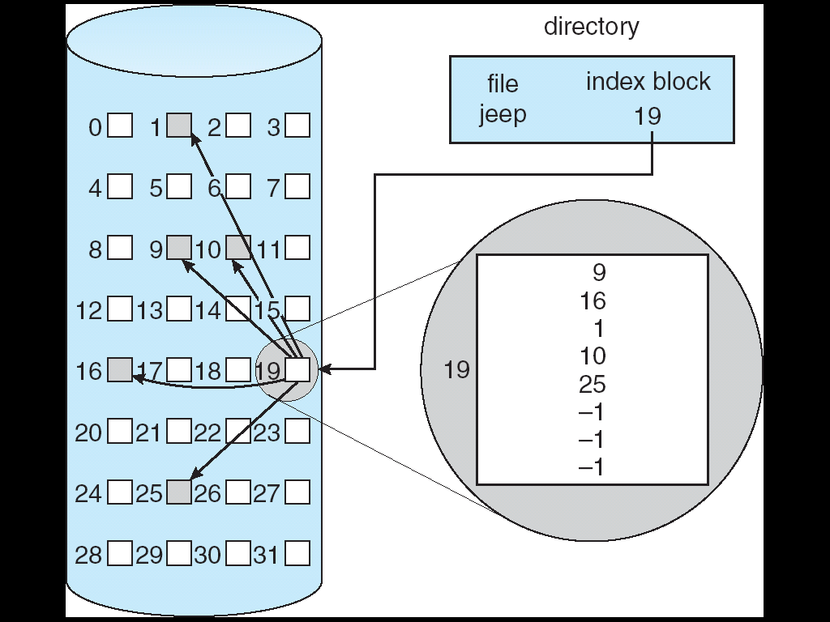

Slide 41
Different mechanisms for creating index block of appropriate size are:
Linked Scheme
Index block is normally one disk block.
Many index blocks linked together.
Multilevel Scheme
Index blocks are leveled.
One index level points to certain other n blocks.
Combined Scheme
Uses both linked and multilevel.
First few are direct pointers.
Last few are indirect pointers.

Slide 42
Comparison of File Allocation Methods
Contiguous allocation requires just one disk access for both sequential and direct access
Linked allocation is good for sequential access. Not suitable for direct access - for accessing i^{th} block, it might require i disk accesses
Indexed allocation more complex – if index block already in memory, then access can be made directly. Else requires two accesses – to read index block and read desired data block
Notes:
Evaluate for data storage efficiency & data block access times

Slide 43
Free Space Management
To keep track of free disk space, the system maintains a free-space list.
The free – space list records all free disks blocks, those not allocated to some file or directory.
Ways to implement free space list
Bit Vector
Linked List
Grouping
Counting
Notes:
When space is allocated it is removed from free space – list
When file is deleted, its disk space is added to free space list

